Slide 1
Communication in online learning
Razia Isaeva
Khazar University
UTRAIN project
26.09.2023

Slide 2
Agenda
Agenda
1. Who am I?
2. Introduction
3. Importance of communication in online learning
3. Impact of an online communication
4. Students’ variable
5. Teachers’ variable
6. Institutional variable
7. Design for balanced LMS

Slide 3
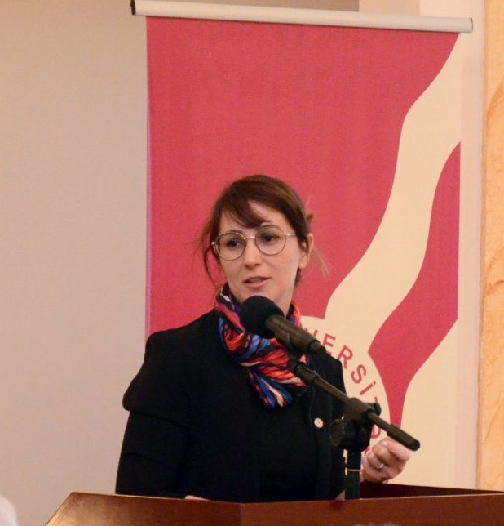
Who am I?
Director of development of Khazar University
Teaching Managerial subjects for more than 20 years, courses include OB, HRM, MGT, Educational Leadership, Creativity and Innovation in Education
Researching HE, specifically Student Engagement
Working with EC projects for more than 20 years
Leading international, multicountry projects for more than 20 years
ERASMUS+ Higher Education Reform Expert

Slide 4
Introduction
Covid-19 has awakening mode for HE around the World about the possibilities internet and technology offers
It also has created many obstacles – isolation, one-way communication
Not all universities were ready to adapt quickly
Not all teachers and students were ready for massive online learning

Slide 5
Importance of communication in online learning
Collobarative learning promotes deep learning, critical thinking, shared understanding, long-term retention (Garrison, Anderson and Archer, 2001)
Built-in communication creates a community of learners (especially during Covid-19 outbreak it was important that students do not feel isolated)

Slide 6
Impact of an online communication
Community development – online interactions, interaction with peers and facilitators (Nagel et al.,2009)
Some studies have found that students are looking for entertainemnt in online communication
Nevertheless, online leraning should be well facilitated and inclusive to stimulate the particaption of the introverts
Some studies indicated that online dynamic discussions impacts the course completion (Davies and Graff, 2005; Swan et al., 2000)
‘Invisible’ students had low grades and completion rates (Nagel et., 2009)

Slide 7
Student Variables
Self-direction
Self-determination
Self-regulation
Procrastination because of feeling isolated
Lack of certain skills – language, writing, and technology
Student’s preference of richer communication like dialogue (Isaeva et al., 2020)

Slide 8
Total transition to online education – 2020 Case of one University in Azerbaijan
Gender
Male – 50%
Female – 47.50 %
LGBT – 2.5 %
Years of study
1st – 22.50%
2nd – 27.50%
3rd – 17.50%
4th – 25%
5th – 7.5%
Schools
Economics and MGT – 85%
Humanities, Education and Social Sciences – 15%

Slide 9
Benefits of online learning according to students
57.50% of students think that it saves time
While 53.50% think it is comfortable to learn from home, 30% remained neutral
Flexibility faced doubt where 35% agreed, 33,5% disagreed, and 32.50% remained neutral
52% think it reduced the cost
46% disagreed that it presents more networking opportunities
Increased computer literacy - majority of students remained neutral (probably indicating that if there is no guidance, students do not benefit and learn)

Slide 10
Student Experiences with online learning
More than 13% of students had no prior online learning experiences before Covid-19
More than 62% of them used social media before
54% never used writing blogs
Although more than 44% used to do online assignments
More than 64% of students said that they better learn in face-to-face classes than in online
More than 35% of students were not satisfied with the quality of student-teacher interactions during online classes
Over 40% of students were not satisfied

Slide 11
Online vs face-to-face
62% of students used smartphones to access online classes
75% of students preferred to have video-conferencing
More than 40 % of students were not satisfied with online learning
67% of students said that they prefer to have face-to-face classes
“I think that online classes don’t have the same effect as our normal classes. Therefore, I don't prefer any of the means of online teaching.”

Slide 12
Teachers’ variables and challenges
Pedagogical and technological skills and abilities
Digital Competence - being able to access and deploy digital resources for pedagogical purposes (Gudmundsdottir & Hatlevik, 2018)
Teachers’ high repertoire of teaching methods
Ability to manage online discussions
Facilitating skills
Challenges
‘Invisible’ students
Reinforcement of participation (compulsory vs voluntary)
Strong communication skills

Slide 13
Institutional variables
Support resources easily available
Training and development opportunities
Regular discussions of the issues with other colleagues

Slide 14
Design for balanced LMS
Synchronous model
Asynchronous model
Foster collaboration
Structure assignments in a colloborative way
Convey critical messages through the online platform

Slide 15
Useful techniques
Modelling (Collins et al., 1987)
Scaffolding (Collins et al., 1987)
Coaching (especially peer-to-peer) (Dennen, 2003)
Rubrics
Feedback
Consultancy online

Slide 16
THANK YOU!

