Slide 1


Advocacy Establishment For Students
Through Ombudsman Positions
(AESOP) Project Implementation and Its
Impact on University Development
Razia Isaeva, HERE, ERASMUS+
Director of Development, Khazar University
Akaki Tsereteli State University
15-16, July 2019
Kutaisi, Georgia

Slide 2
Project objectives
Creation of a Student Advocacy Office in each university headed by a full-time, trained ombudsperson who will offer training and support services.
Improving the administration of partner universities
Enabling partner universities to implement the Bologna Process not only as a formality but in the full sense of the spirit of the Process, giving students access to the democratic processes that are used to make decisions about their education.

Slide 3
European values addressed in the educational projects
Promoting equity, social cohesion and active citizenship is one of the strategic objectives for cooperation in education and training at the EU-level.
……..‘inclusive education, equality, equity, non-discrimination and the promotion of civic competences’ as priority areas for European cooperation in the field of education and training.
    The Commission and the Council’s 2015 joint report on implementing the ET 2020 strategy
Source: https://ec.europa.eu/education/policies/european-policy-cooperation/inclusive-education_en

Slide 4

Khazar University’s contribution to development of these values
The Establishment of a Foundation for the Integration of Disabled People into HEIs of Azerbaijan - ESFIDIP project – 2013 - 2016
Advocacy Establishment for Students through Ombudsman Position- AESOP project – 2016 - 2019

Slide 5
Impact on Human capital development
…Changes in attitudes, beliefs and understanding generally followed by changes in behavior.
Fullan, M., 1985
Fullan, M., 1985. Change processes and strategies at the local level. The elementary school journal, 85(3), pp.391-421.

Slide 6
Mindful students are better students ….
... we need always to be mindful of the importance of creating an inclusive environment – one in which women and men of all cultural, national, socio-economic and other backgrounds will, so far as possible, feel able to engage on equal terms.
Markwell, D (2007, 19)
Markwell, D . (2007) The Challenge of Student Engagement . Keynote address at the Teaching and Learning Forum. University of Western Australia, 30–31 January.

Slide 7
Human capital development impact of AESOP project
Staff trained within the project - Informed, empathetic, mindful, and considered employees able to provide student engagement in democratic processes (100s of university staff members )
Students trained – empowered students, mindful students (100s of students trained)
100s of students surveyed at each partner university contributed to student awareness on their rights and university regulations
Effectiveness of the process to provide consistent and democratic systems for student advocacy in administrative issues

Slide 8
Project Impact
More than 200 students participated in surveys conducted at Khazar University – the result show clear impact of the project
Majority of students (92%)are aware of the Ombudsman Office established and know where they can go in case of a problem
69 % of students say that they will inform their mate about the procedure
94 % of students responded that they will go to Ombudsman Office if needed

Slide 9
Project Impact….
Have you benefited from the training?
Will you inform your student mates about Ombudsman office?
Will you go to Ombudsman office in case of any problems?
Do you think that there is a need for Ombudsman office?
Have you learned enough about Ombudsman office functions?
Do you know to whom to go in case of you have any problems during your studies?

Slide 10
I have been able to solve my problems at University
1 - not at all
2 - to low extent
3 - average
4 - to some extent
5 - to high extent
6 - no response

Slide 11
I know my rights as a student
1 - not at all
2 - to low extent
3 – to an average extent
4 - to some extent
5 - to high extent

Slide 12
I know where to find the written rules and policies of my university
1 - not at all
2 - to low extent
3 – to an average extent
4 - to some extent
5 - to high extent

Slide 13
I trust my university administration to deal with my problems fairly

Slide 14
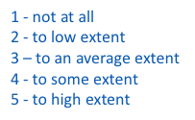
Administrators and university staff are friendly , helpful and supportive

Slide 15
The university administration deals with my problems in a timely manner

Slide 16
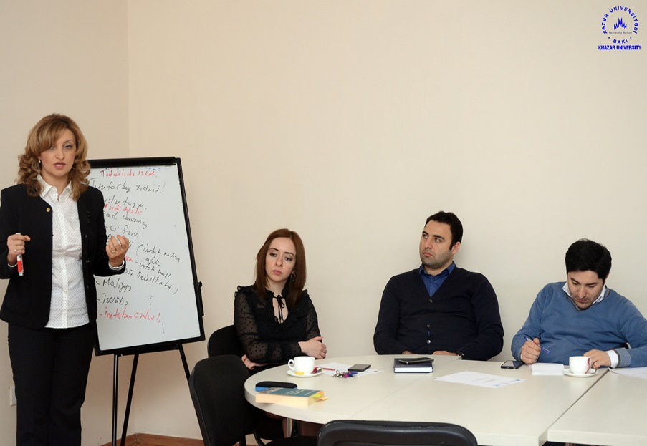
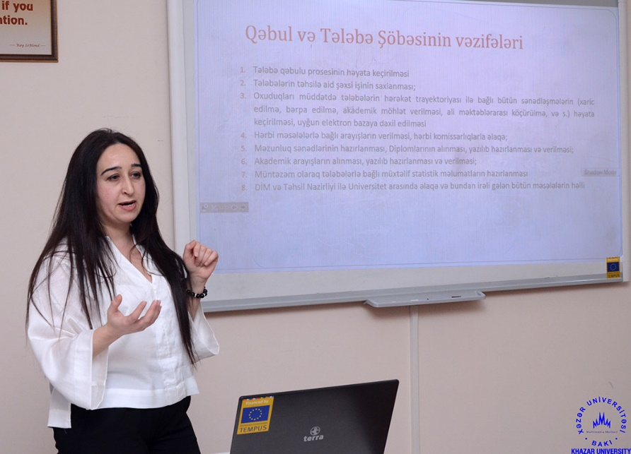
Sustainability
To turn ombudsperson into the stakeholder/strategic partner of education process
To provide continues trainings for staff members
To organize constant surveys and focus groups with students to be able to provide that open and democratic environment

Slide 17
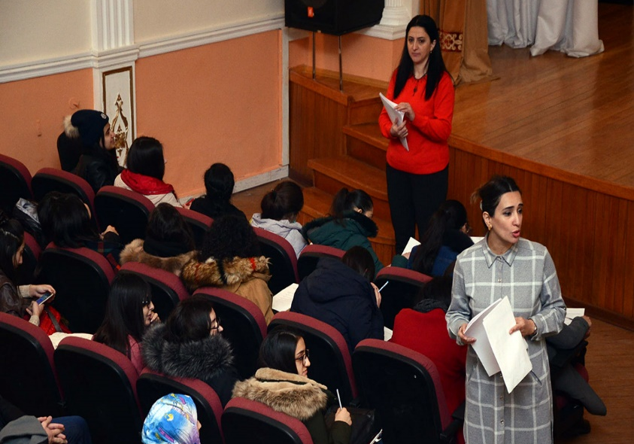
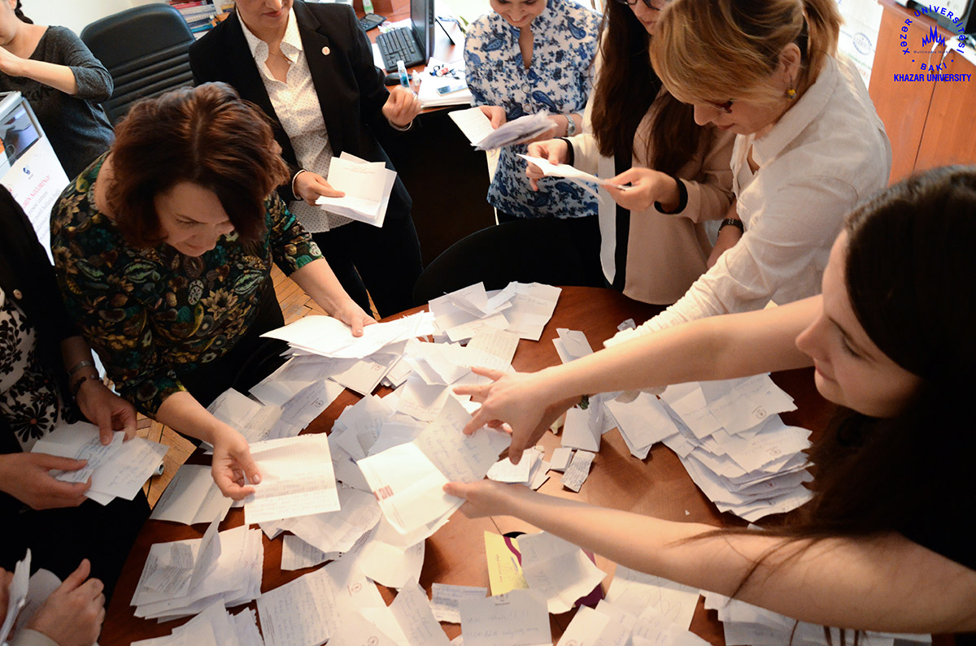
Sustainability
To engage students in decision making process
To collaborate regionally with other partners
To join Networks (European and others)

Slide 18
Thank you!

