Slide 1
Regional Conference
Azerbaijan-Georgia
Khazar University
5 October 2018

Slide 3
Paving the way for interregional mobility and ensuring relevance, quality and equity of access

Slide 4
PAWER is an Erasmus+ Capacity Building in the field of Higher Education project with a very ambitious objective. Five European Universities would support the modernization, accessibility and internationalisation of 23 universities from 8 different countries in 4 different regions.

Slide 5
PAWER OBJECTIVES
To share the knowledge of the credit system used in each partner country
To analyse the actual meaning of “credit” in each partner institution, and to develop common methodology for the definition of Learning Outcome and workload
To share information on how the ECTS are applied and used in the partner countries that already adopted the system, or will be applied in those that are going to join EHEA
To enhance the human resource capacity in planning, delivering, and evaluating degree courses
To implement concrete pilot examples in some degree courses developed by the partners in the framework of previous joint projects
To analyse the grade system in each country and in each partner institutions, and make a concrete comparison in the selected degree courses
To collect data on credits recognition and grade transfer in the implemented and ongoing EMA2 and Credit Mobility projects in the 4 regions
To provide a table with percentage of students’ performances in the last 3 years in at least 5 fields of study (ISCED) among the pilot courses
To establish follow up actions in cooperation with EU universities by signing bilateral agreements in view of “Credit Mobility”programme calls and inter-institutional cooperation

Slide 6
PARTNERS
University of L’Aquila, Italy
Wroclaw University of Environmental and Life Sciences, Poland
University of Szeged, Hungary
Middlesex University Higher Education Corporation, UK
University of Chemical Technology and Metallurgy, Bulgaria

Slide 7
Partners
Russia (2 universities +MoE)
Mongolia (2 universities + MoE)
Uzbekistan (3 universities + MoE)
Tajikistan (4 Universities + MoE)
Kazakhstan (4 Universities + MoE)
Kyrgyzstan (3 Universities + MoE)
Georgia (3 Universities + MoE)
Azerbaijan (2 Universities + MoE)

Slide 8
Policy Development on Internationalization: The Case of Credit Recognition

Slide 9
Rational behind Internationalization policy in Azerbaijan (based on the “Azerbaijan 2020: Look into the Future” Concept of Development )
Human resources capacity building
Internationalizing staff
Developing international cooperation
Economic rational

Slide 10
Vision of Khazar University
The vision of the university is to become a world-class higher education institution, recognized for its excellence in education and research, as well as a wide-ranging partnership with the stakeholders on national and international levels.

Slide 11
Emphasis of internationalization policy at Khazar
Academic freedom and institutional autonomy
Shared benefits, mutual respect and fairness
Equity in access to internationalization opportunities

Slide 12
Performance Indicators for Internationalization at Khazar University
Performance Indicators | Current situation | Target (next 5 yrs)
Percentage of international students | 15 % | 25%
Percentage of international academic staff | 25% | 40%
Percentage of strategic partnership | 28% | 45%
Percentage of co-authored with international partners | 60% | 80%
Number of operational MOUs | 30 | 50
Research funding generated from international sources | 10% | 45%
Number of countries of incoming students | 36 | 80
Institutional performance in international league tables | QS ranking world’s top 750 universities | Times higher education

Slide 13
Projects supporting internationalization

Slide 14
Khazar University Scholarship Programs
Merit-based scholarships
All foreign and Azerbaijani citizens are eligible
Full tuition fee covered
Available for potential students of all four schools of the University
Bachelor, Master and PhD programs

Slide 15
‘The body of knowledge is more than a series of techniques and rules.’ Ramsden, P., 2003. Learning to teach in higher education. Routledge.

Slide 16
Benefits of Policy development
Institutional memory is developed
Minimization of human factor
Guidance for easy management

Slide 17
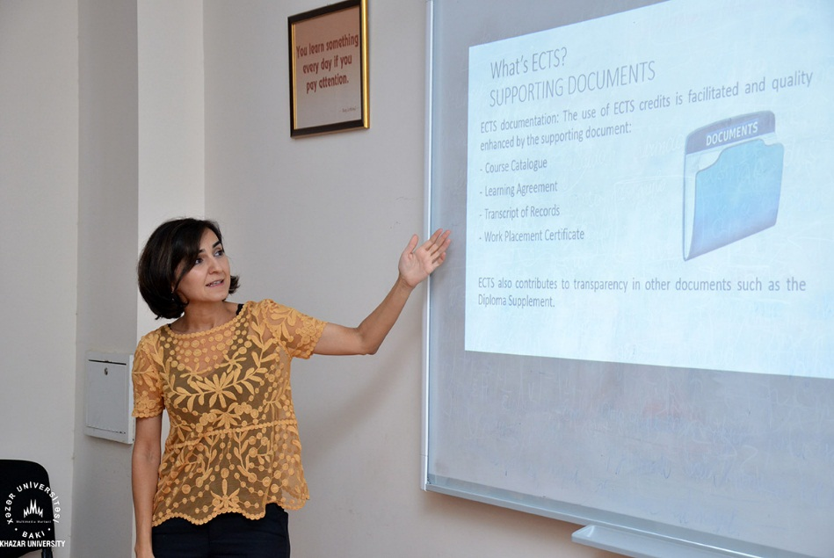
Retraining within PAWER
1) Credit Recognition
2) Policy Gap

Slide 18
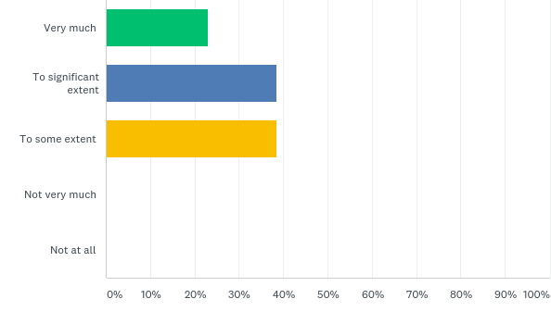
Do you consider policy document critical to perform your job?

Slide 19
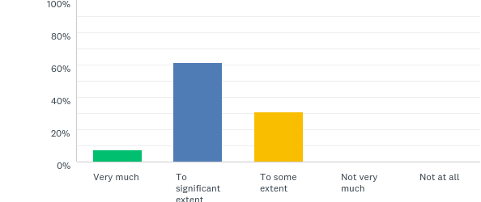
Do you refer to policy to solve issues in your daily job?

Slide 20
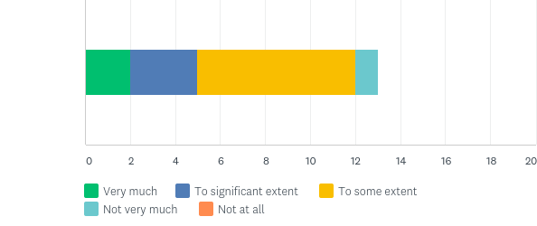
Do you consider policies you have at university enough or qualified to solve issues you have on your job?

Slide 21
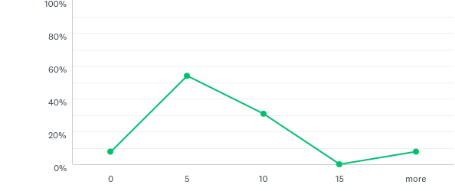
How many times in a week you refer to policy to perform your primary job?

Slide 22
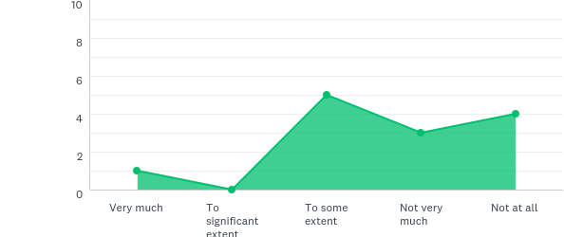
Do you think that current policy on Credit Recognition helps you to solve issues effectively and efficiently?

Slide 23
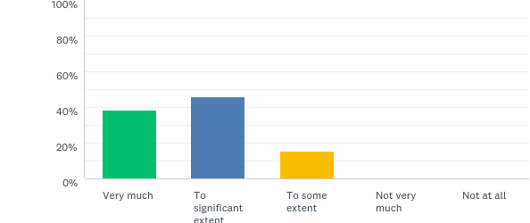
How detailed the policy on Credit Recognition should be?

Slide 24
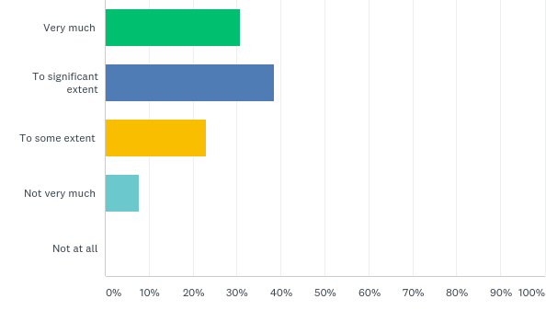
Do you see a need to add some indicators (number of hours, number of credits, equivalents of credits) mentioned in the policy for Credit Recognition?

Slide 25
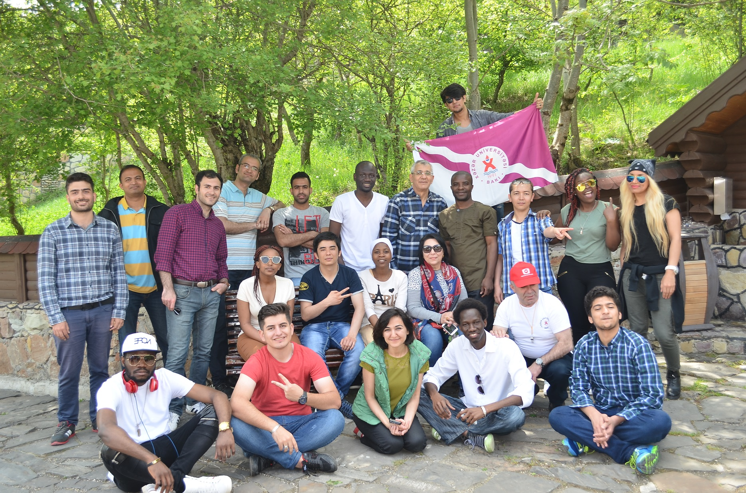
International community of Khazar university
Annual Meeting of the International Community

Slide 26
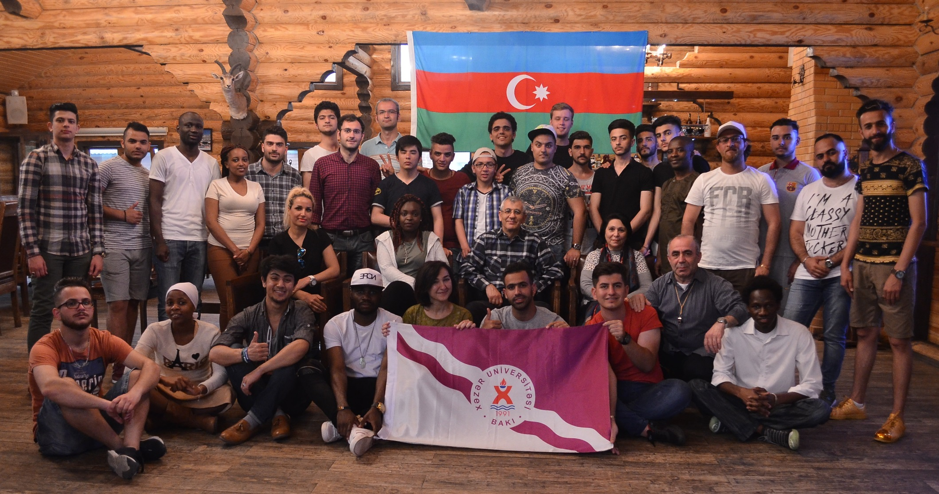
International community of Khazar university
Annual Meeting of the International Community

