Slide 1


State-religion Relations in Azerbaijan
Thomas Liles
US Fulbright Fellow, Azerbaijan
International Fellow, CRRC

Slide 2
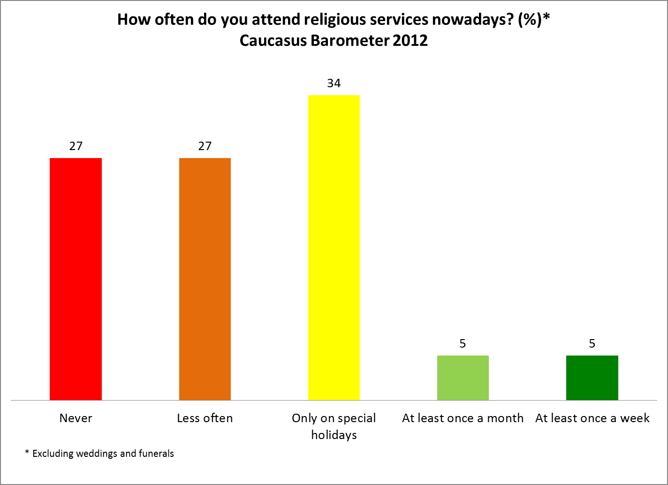

Slide 3
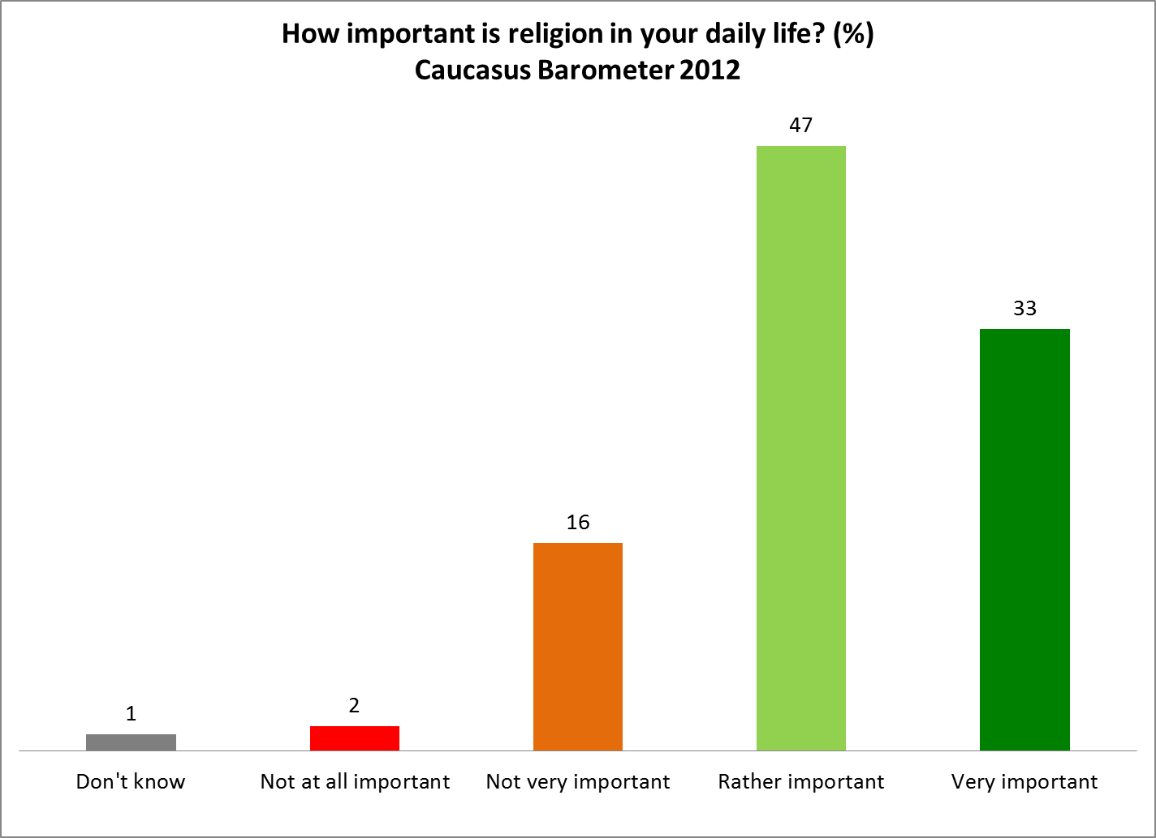

Slide 4
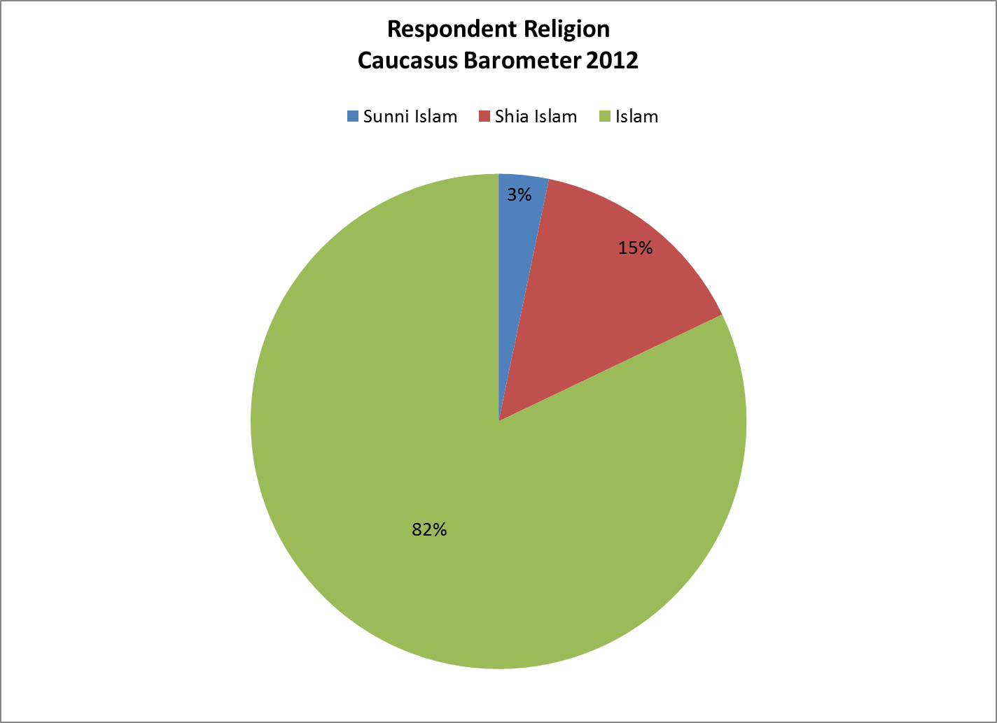

Slide 5
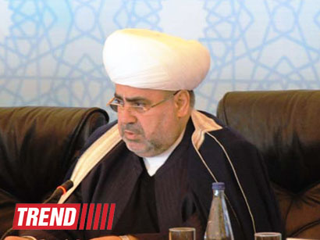
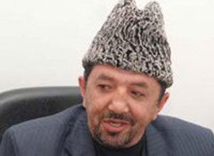
Caucasus Board of Muslims
Sheikh-ul-Islam
Allahshukhur
Pashazade
Mufti Salman
Musayev

Slide 6
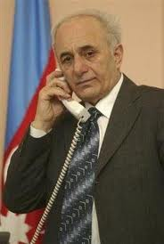
State Committee on Work with Religious Organizations 2001-2006: Inception
“We established the full interrelation between the State Committee, [religious] communities, and the centers which controlled them from abroad.”
“In effect, we subsumed 30 of the most important points from the [CBM’s] charter. It was nearly a two-year struggle….and the CBM’s mandate was lowered to that of an NGO.” - Rafik Aliyev, SCWRO Chairman, 2001-2006

Slide 7
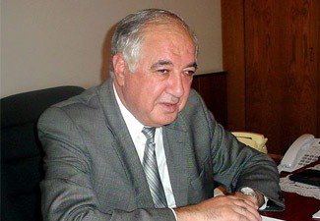
SCWRO 2006-2012: Disengagement and Deterioration
“In Azerbaijan, freedom of religion is respected in every sense of the word.”
“I would even … say that in Azerbaijan there is no need for a law on religion.” - Hidayat Orujov, SCWRO Chairman, 2006-2012

Slide 8
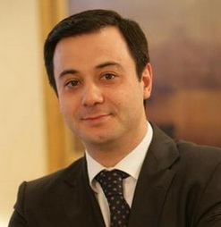
SCWRO 2012-present: Policy Shift or Continuity?
“In Azerbaijan there exists a model of [inter-religious] tolerance which could become an example for other states.” - Elshad Iskenderov, current SCWRO Chairman, at III Kiev Inter-religious Forum

Slide 9
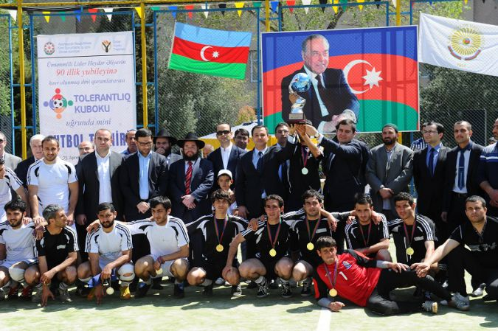
“Cup of Tolerance”

Slide 10
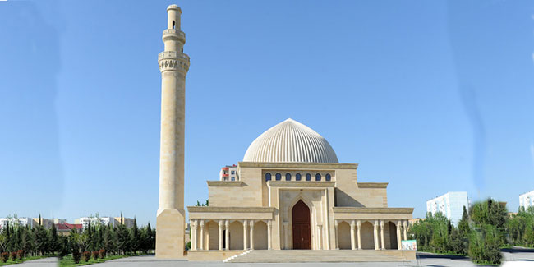
Sumgait Juma Mosque

Slide 11
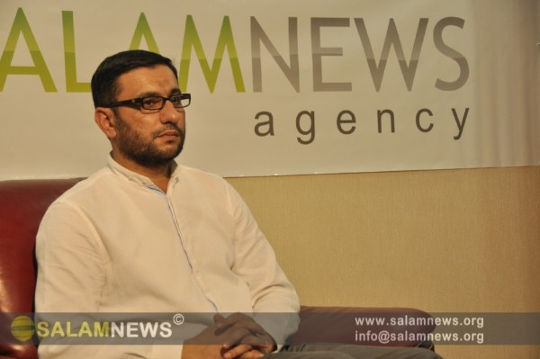
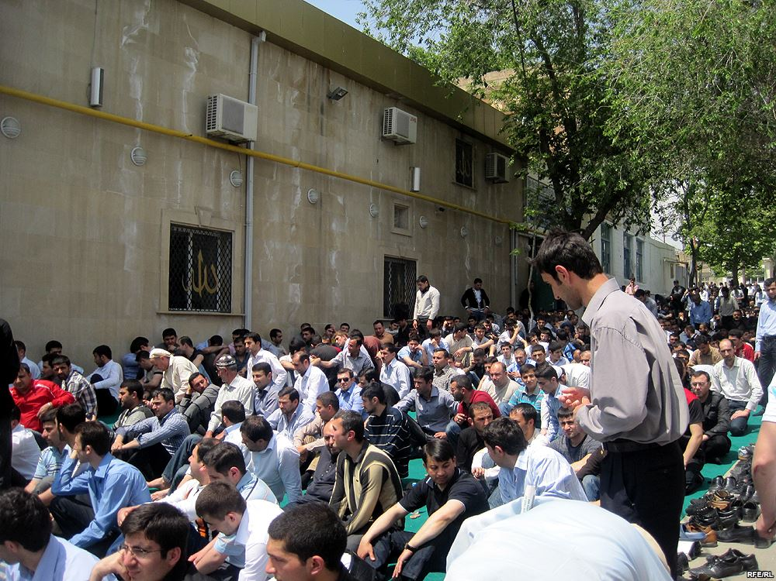
Shahin Hasanli (Mashadi Dadash Mosque)
“[Our] relations with the state are now normal, there aren’t any problems with our community … Positive conditions are now being created for religious communities, and state structures are striving toward dialogue with communities.”

Slide 12
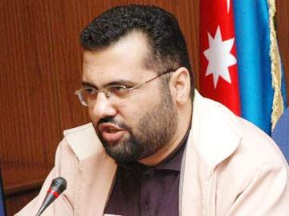
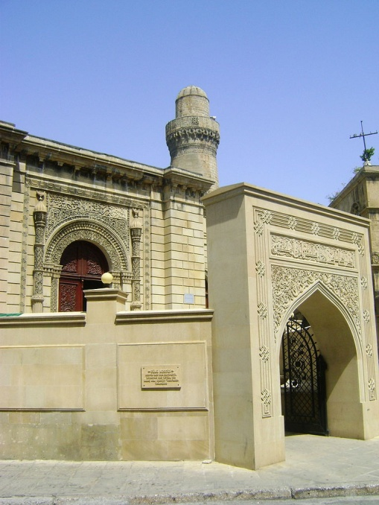
Ilgar Ibrahimoglu (Juma Mosque)
“I think that Iskenderov is a serious professional who can solve problems affecting religious groups … but without a solution to our two major problems, no improvement in relations is possible.”

Slide 13
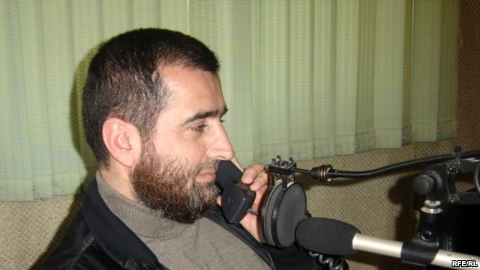
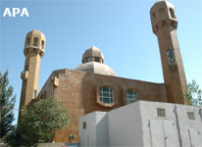
Gamet Suleymanov (Abu Bakr Mosque)
“Iskenderov is a professional; after his appointment, the religious situation here became a bit more stable … Of course, there are still very few mosques, especially in Baku and especially for Sunnis.”

Slide 14
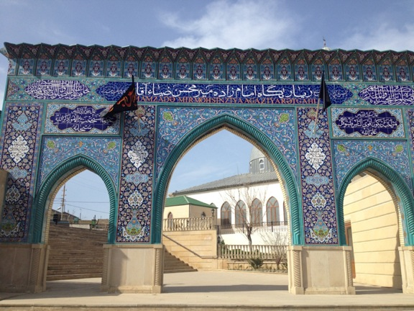
Thank you!

Slide 15
Photo and Data Credits
www.1news.az
www.azadliq.org
commons.wikimedia.org
www.crrccenters.org
www.news.az
www.radioazadlyq.org
ru.apa.az
www.salamnews.org
http://www.scwra.gov.az/
www.xeber44.com

